Slide 1
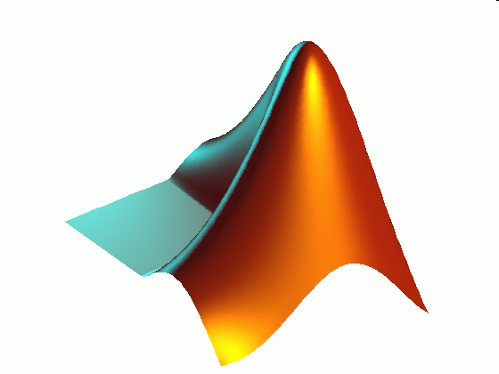
ME 203 Introduction to MATLAB
1

Slide 2
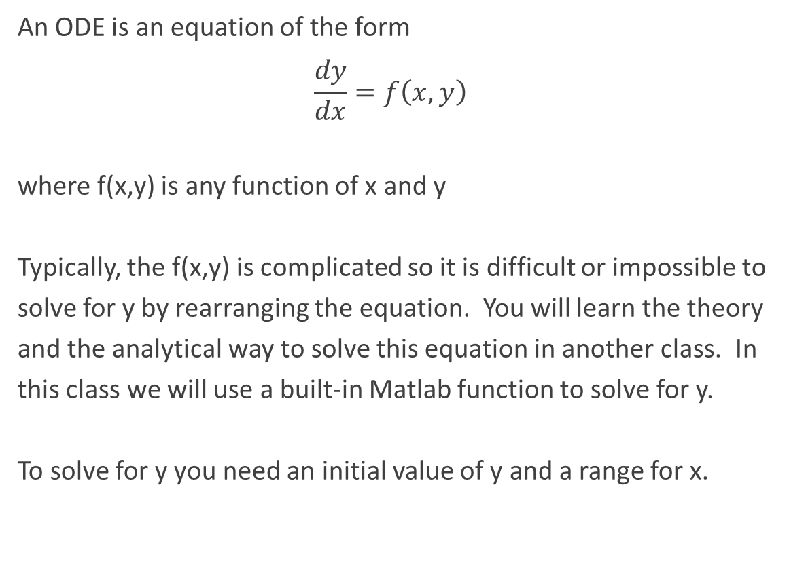
ODEs (Ordinary Differential Equations)
An ODE is an equation of the form
$$\frac{dy}{dx}=f\left(x,y\right)$$
where f(x,y) is any function of x and y
Typically, the f(x,y) is complicated so it is difficult or impossible to solve for y by rearranging the equation. You will learn the theory and the analytical way to solve this equation in another class. In this class we will use a built-in Matlab function to solve for y.
To solve for y you need an initial value of y and a range for x.

Slide 3
ode45
[X, Y]=ode45(@f, [X-range],[Y-initial value])
f: previously defined function whose input arguments are x and y
X-range: initial and final values of the independent variable
Y-initial value: initial value of the dependent variable

Slide 4

ODE Example 1
Solve the ODE
$\frac{dy}{dx}+10y=0$
Use: x=[0, 0.5], y(x=0)=2. Plot the solution.
x-range: 0 to 0.5
Initial value (i.e., when x=0) of y: y(0) = 2
$\frac{dy}{dx}=−10y$
Find: Plot y vs. x

Slide 5
ODE Example 1
Define the function file:
Call the function from another script file or command window:
function dy_dx = odeexample1 (x,y)
dy_dx = -10*y;
end
%ODE example 1
clc, clear all, format compact
%Given
x_range = [0, 0.5];
y_initial = 2;
[x, y] = ode45 (@odeexample1, x_range, y_initial);
plot(x,y)
xlabel('x')
ylabel('y')

Slide 6
ODE Example 1

Slide 7
ODE Example 1
Alternatively, one can use a function handle within the script file instead of defining a separate function file
%ODE example 1 - another method
clc, clear all, format compact
%function handle
fun = @(x,y) -10*y;
[x,y] = ode45 (fun, [0, 0.5], 2);
plot(x,y)
xlabel('x')
ylabel('y')

Slide 8
ODE Example 1
Alternatively, one can use a function handle within the script file instead of defining a separate function file
%ODE example 1 - another method
clc; clear all; format compact
[x,y] = ode45 (@(x,y) -10*y, [0, 0.5], 2);
plot(x,y)
xlabel('x')
ylabel('y')

Slide 9

ODE Example 2
Solve the ODE: $\frac{dy}{dx}=−2y^{3}+x−y$
Given: x=[6, 24], y(x=6)=-3, Find: Plot y vs. x
%ODE example 2
clc; clear all; format compact
%given
x_ran = linspace(6,24,100); %to divide the x range into 100 steps
y_ini = -3;

Slide 10
ODE Example 2
%function handle
fun2 = @(x,y) (-2*y.^3+x-y);
[t,y] = ode45 (fun2, x_ran, y_ini);
plot(t,y), xlabel('t'), ylabel('y')

Slide 11

Example 3: Second order ODEs
Given: t ϵ[0,5],
x(0)=0.05,
$\frac{d\text{x}}{dt}$(0)=0
$\frac{d^{2}x}{dt^{2}}=−9x$
Find: Plot x vs. t and dx/dt vs. t

Slide 12

Example 3: Second order ODEs
$\frac{d\text{x}}{dt}$(0)=0
$\frac{d^{2}x}{dt^{2}}=−9x$
First, rewrite equations
z=$\frac{dx}{dt}$
$\frac{d\text{z}}{dt}\text{=}−9x$

Slide 13
Example 3: Second order ODEs
Write main code
clear all; clc; close all; format compact
% X range
t_start = 0;
t_final = 5;
t_range = [t_start t_final];
% Initial Values
xo = 0.05;
dxo_dt = 0;
initial = [xo dxo_dt];
% Solve for x, y, dy/dx
[x s]=ode45('second_order_odes',t_range,initial);

Slide 14
Example 3: Second order ODEs
Write function file
function [output] = second_order_odes(tn,sn)
% Outputs single order Differential equations for ODE45
% tn = nth iteration (will give warning by MATLAB here)
% sn = solution matrix for nth iteration
% Define variables in solution matrix sn
X1_dot=sn(1);
X2_dot=sn(2);
% Create space for solution
output = zeros(2,1);
% Set of equations to solve
output(1) = X2_dot;
output(2) = -9*X1_dot;
end

Slide 15
Example 3: Second order ODE
Finish main code
%Plot y vs. x
subplot(1,2,1)
plot(x,s(:,1))
xlabel('x')
ylabel('y')
%Plot dy/dx vs. x
subplot(1,2,2)
plot(x,s(:,2))
xlabel('x')
ylabel('dy/dx')

Slide 16

Example 4: Second order ODEs
Given: tϵ[0 2], x(0)=0, $\frac{d\text{x}}{dt}$(0)=0 $, \frac{d^{2}x}{dt^{2}}=cos⁡(x)$
Find: Plot x vs. t and dx/dt vs. t
Rewrite equations
z=$\frac{dx}{dt}$
$$\frac{d\text{z}}{dt}\text{=}cos(x)$$

Slide 17
Example 4: Second order ODEs
Write main code
clear all; clc; close all; format compact
%X range
t_start=0;
t_final=2;
t_range=[t_start t_final];
%Initial Values
xo=0;
dxo_dt=0;
initial=[xo dxo_dt];
%Solve for x, y, dy/dx
[x s]=ode45('second_order_odes2',t_range,initial);

Slide 18
Example 4: Second order ODEs
Write function code
function [output] = second_order_odes(tn,sn)
% Outputs single order Differential equations for ODE45
% tn = nth iteration (will give warning by Matlab here)
% sn = solution matrix for nth iteration
% Define variables in solution matrix sn
X1_dot=sn(1);
X2_dot=sn(2);
% Create space for solution
output = zeros(2,1);
% Set of equations to solve
output(1) = X2_dot;
output(2) = cos(X1_dot);
end

Slide 19
Example 4: Second order ODEs
Finish main code
%Plot y vs. x
subplot(1,2,1)
plot(x,s(:,1))
xlabel('x')
ylabel('y')
%Plot dy/dx vs. x
subplot(1,2,2)
plot(x,s(:,2))
xlabel('x')
ylabel('dy/dx')

